Slide 1
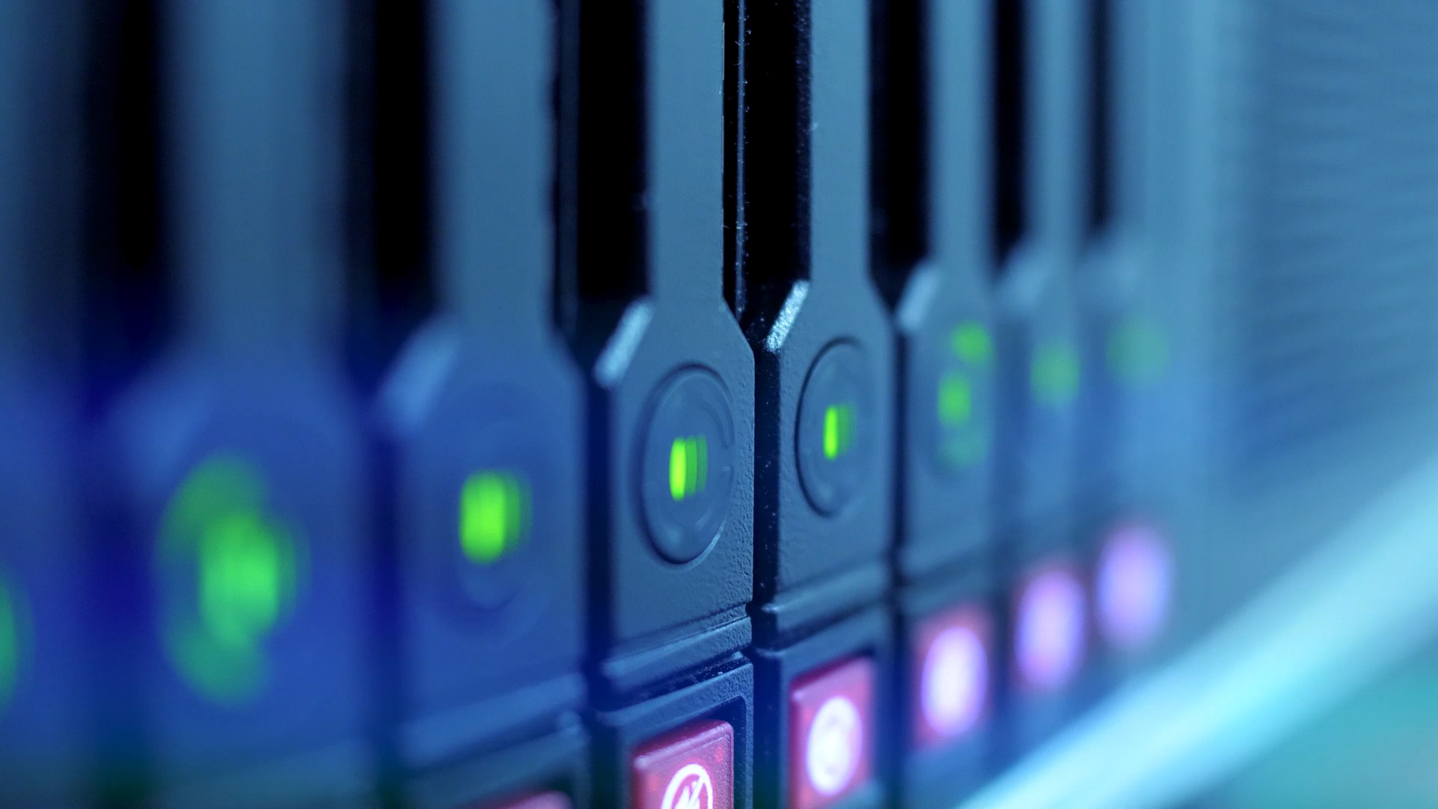
A brief history of ComputerS
Jakub Mikulski & Roch Mykietów

Slide 2
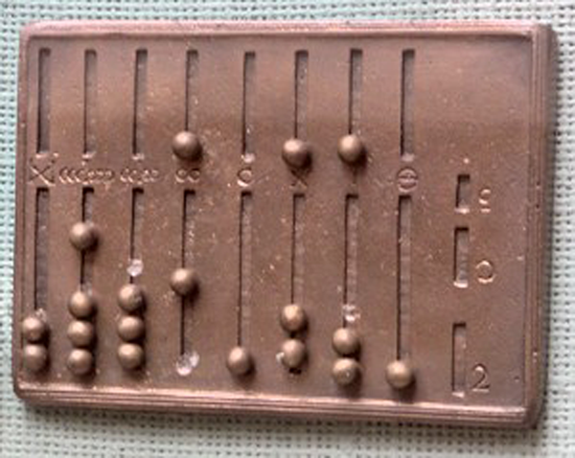
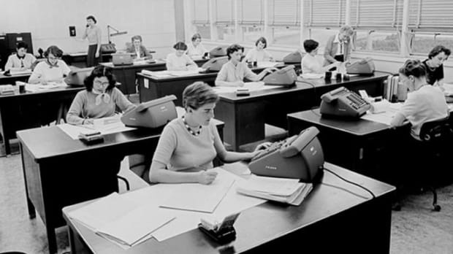
What is a computer?
A computer is a digital electronic machine that can be programmed to carry out sequences of arithmetic or logical operations (computation) automatically.
Notes:
But that is a modern definition of computer. The word came from „compute” which means to calculate, now it also means to use a computer or calculator. So a computer is a machine that calculates, or a person. Believe it or not but a computer is also a job. For example: during the early days of space travel in the 1960s most of the calculations were done by mathematicians also known as computers.

Slide 3
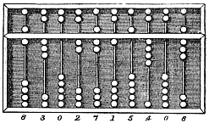
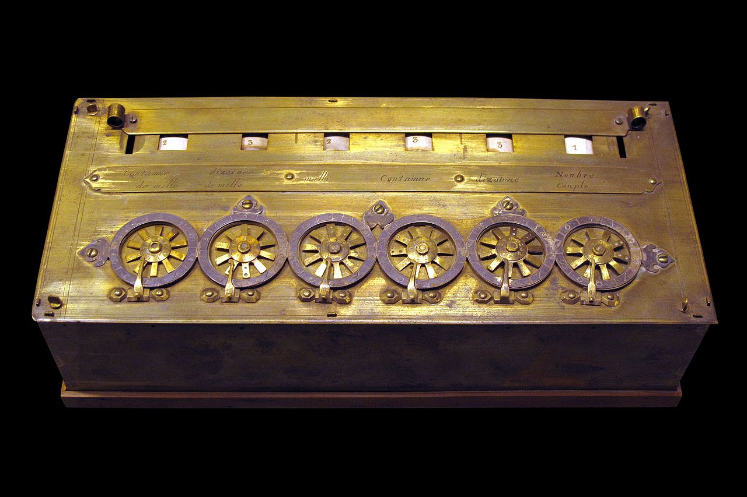
When did it start?
Some says that the beginning of the computing was an invention of abacus 3000BC in China.
The first 'calculator' was made by mathematician Blaise Pascal in 1642, he made first mechanical calculator was named "Pascalin"
Notes:
but let's be honest, there's no any 'automation' we want, because the user still had to make all calculations by hand. and it could add two numbers... speeding at least addition.

Slide 4
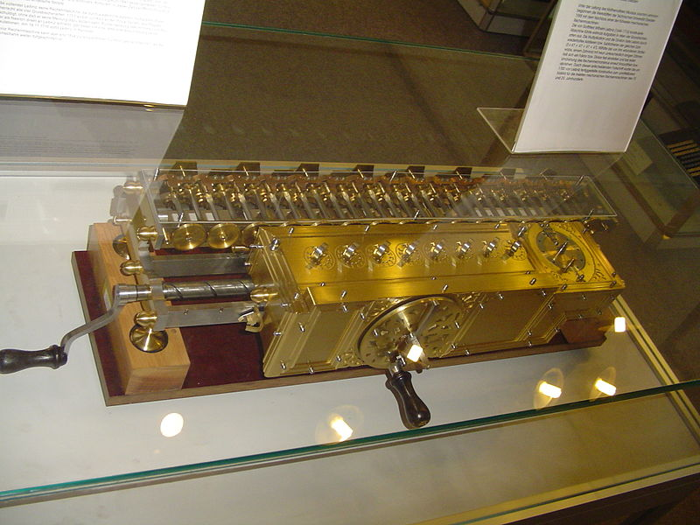
Stepped reckoner
Shortly after that, Gottfried Leibniz, constructed mechanical calculator that could do all 4 basic arithmetic operations, addition, subtraction, multiplication and division
Notes:
, and made basic concepts of binary number system which is the basics of all computers. It would operate on 8-digit numbers and give 16-digit output

Slide 5
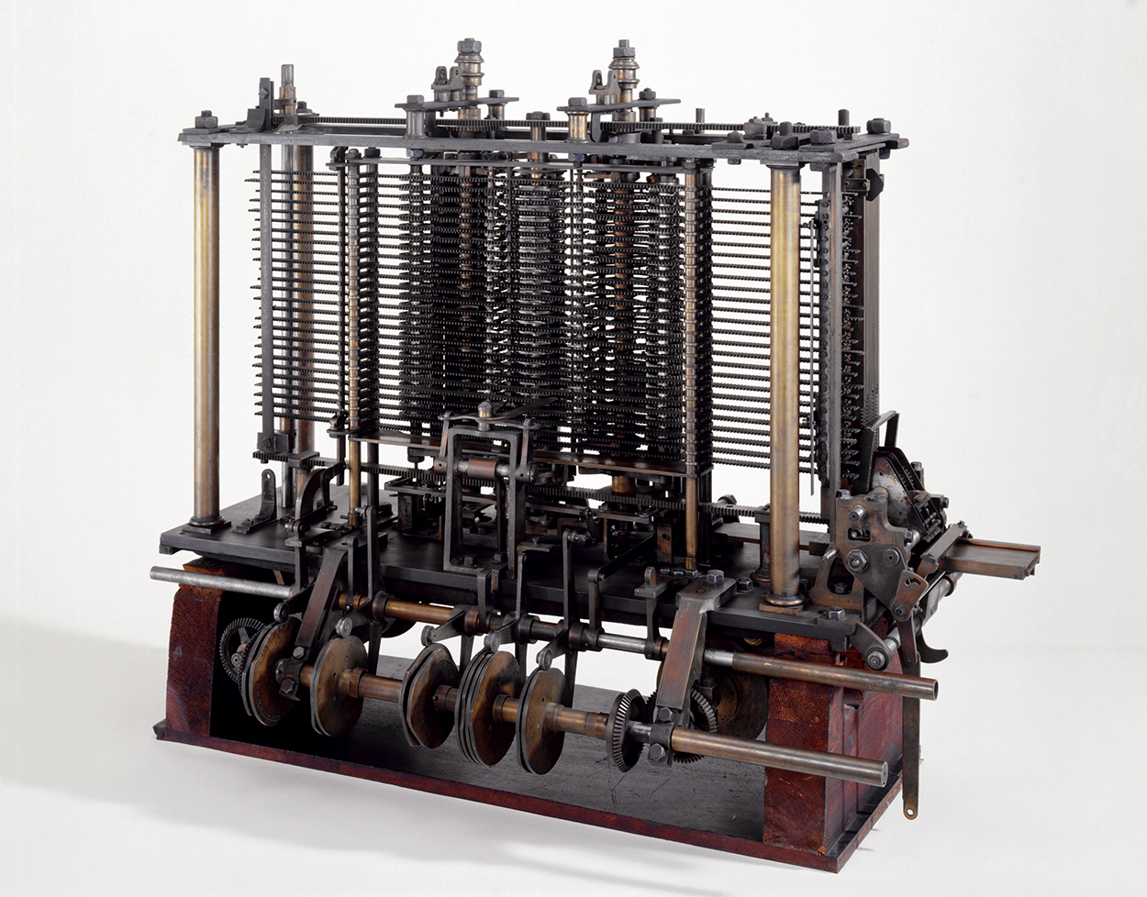
Long after in 1810 the next milestone was made by Charles Babbage.
He saw that a lot of calculations are regularly repeated and that’s why he crated a mechanical engine powered by steam called the „calculator engine”.
Notes:
But he got an even better idea. The Analytical Engine. It incorporated an arithmetic logic unit, control flow in the form of conditional branching and loops, and even integrated memory, making it the first ever design for a general-purpose computer. Unfortunately he was never able to complete construction of his machine due to inadequate funding.

Slide 6
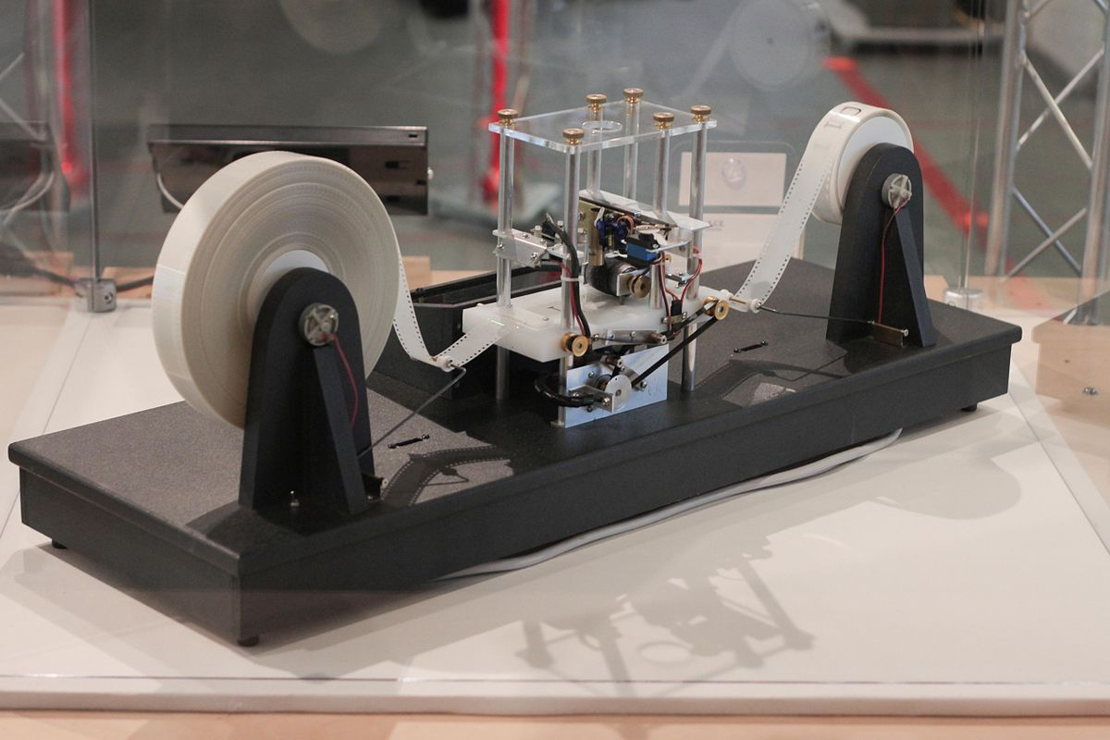
Turing machine
In 1936 Alan Turing proposed a concept of infinite machine that could compute anything that is possible to compute
Notes:
Simply a Turing machine consists of: An infinite tape with storage cells and a read/write-device that can move on the tape. It was designed to show if a computer (or programming language) can, theoretically speaking, complete any algorithm or task given. Turing completeness is the ability for a system of instructions to simulate a Turing machine.

Slide 7
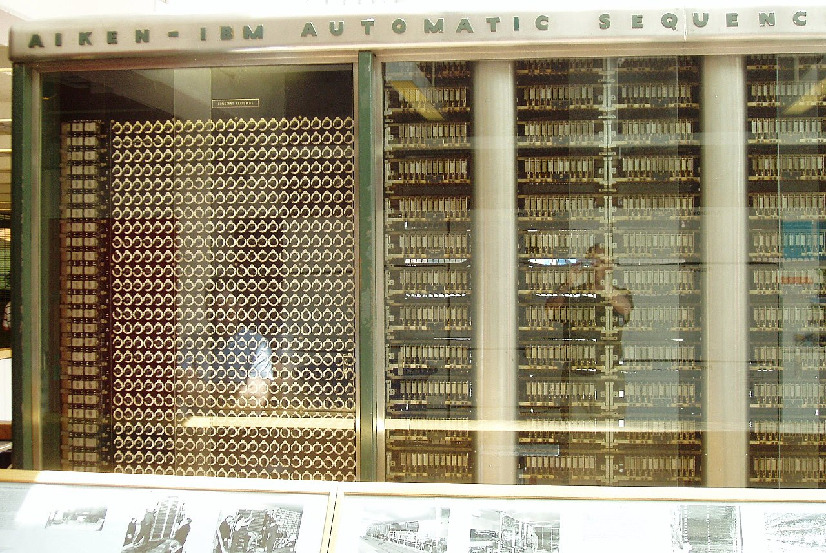
Harvard Mark I
A year later in 1937 Howard Aiken with the IBM began to work on the "Harvard Mark 1 Calculating Machine", a fully programmable calculator inspired by Babbage analytical engine.
Notes:
The machine consisted of around 1 million parts and weighed nearly 5 tons, and was a general-purpose electromechanical computer used during the World War II. FUN FACT: it was used to determine whether implosion was a viable choice to detonate the atom bomb. FUN FACT2: one of the first programmers of this machine, Grace Hopper discovered the first computer bug, which was literally a mole stuck in one of the reading holes... So it is where the 'bug' came from

Slide 8
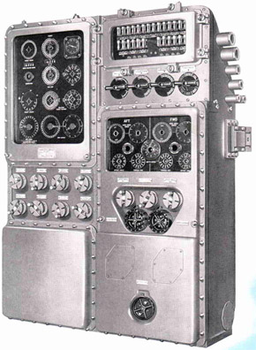
Digital computers
Early digital computers were electromechanical; electric switches drove mechanical relays to perform the calculation, like the Harvard Mark I.
By 1938, the United States Navy had developed an electromechanical analog computer small enough to use aboard a submarine. This was the Torpedo Data Computer.
Notes:
which used trigonometry to solve the problem of firing a torpedo at a moving target. These devices had a low operating speed and were eventually superseded by much faster all-electric computers, originally using vacuum tubes.

Slide 9
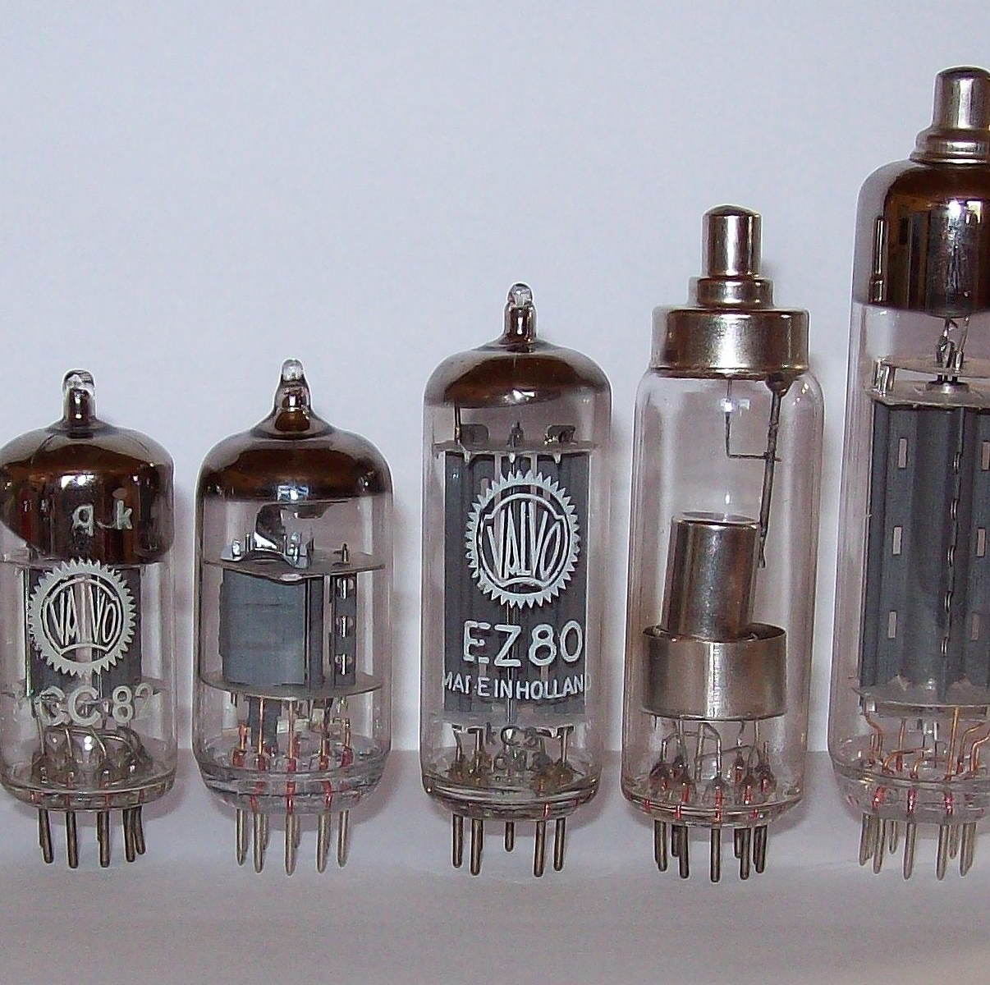
Vacuum tubes
The ABC computer was using vacuum tubes. They worked like modern transistors, but they were using a lot of electricity and they were quickly burning out, but at least they were much faster than their mechanical counterparts.

Slide 10
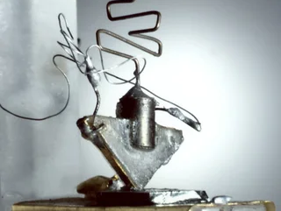
Transistors
In 1947 first transistor was invented and in 1953 first computer was made using transistors (TRADIC), what makes it so special? Transistors need a lot less energy than vacuum tubes, are a lot smaller, much more durable and cheaper.

Slide 11
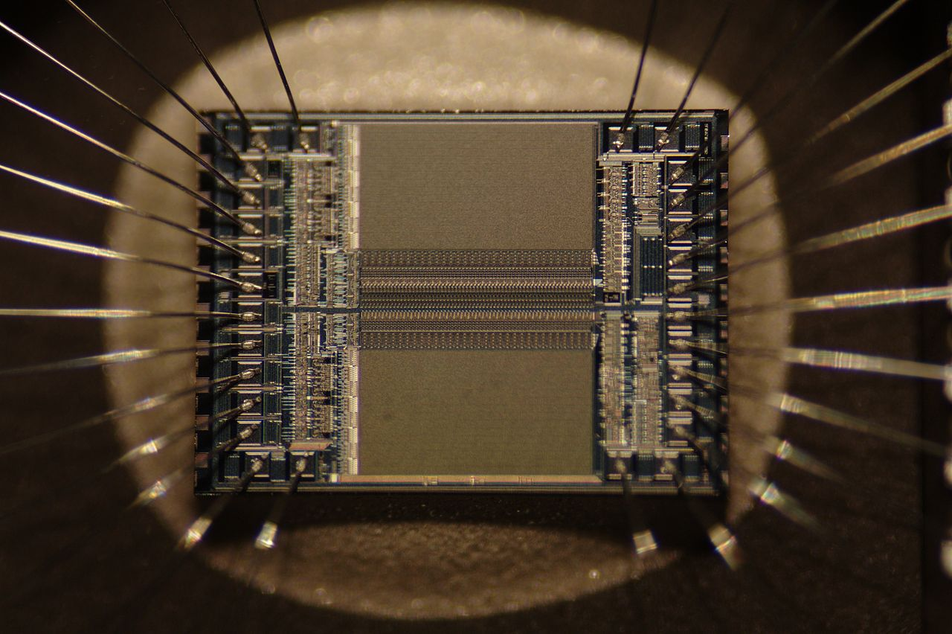
Integrated circuit
Integrated circuit is a set of electronic circuits on one small flat piece (or "chip") of semiconductor material.
Notes:
They were the true breakthrough. They reduced the cost of computers by thousands of Times. They allowed the transistoras to shrink and get cheaper.

Slide 12
The end
Thanks for attention
Sources:
wikipedia
my notes

